Slide 1
Google Project Soli
Presenter: Wenguang Mao

Slide 2
Motivation
Free air gestures for HCI in wearable, mobile, ubiquitous computing
Vision based approaches
Latency
Obstruction
Power
Other RF based approaches
Large scale gesture

Slide 3
Project Soli
Gesture recognition system
Micro-gesture such as pitch and rub
Millimeter wave
60 GHz
Low power, small form factor
300 mW
12 mm * 12 mm
Notes:
System description
Place a specially designed sensor in the table, put your hand in front of it
Trans, reflected, received

Slide 4
Project Soli
Signal processing design
Range-Doppler image
Soli: Ubiquitous Gesture Sensing with Millimeter Wave Radar, SIGGRAPH 2016
Hardware design
Soli sensor: a single chip integrating antennas, RF front end, A/D converter, VCO
A Highly Integrated 60 GHz 6-Channel Transceiver With Antenna in Package for Smart Sensing and Short-Range Communications, IEEE Journal on Solid-State Circuits, 2016
Gesture classification design
Random forest
CNN + RNN
Interacting with Soli: Exploring Fine-Grained Dynamic Gesture Recognition in the Radio-Frequency Spectrum, UIST 2016

Slide 5
System Overview

Slide 6
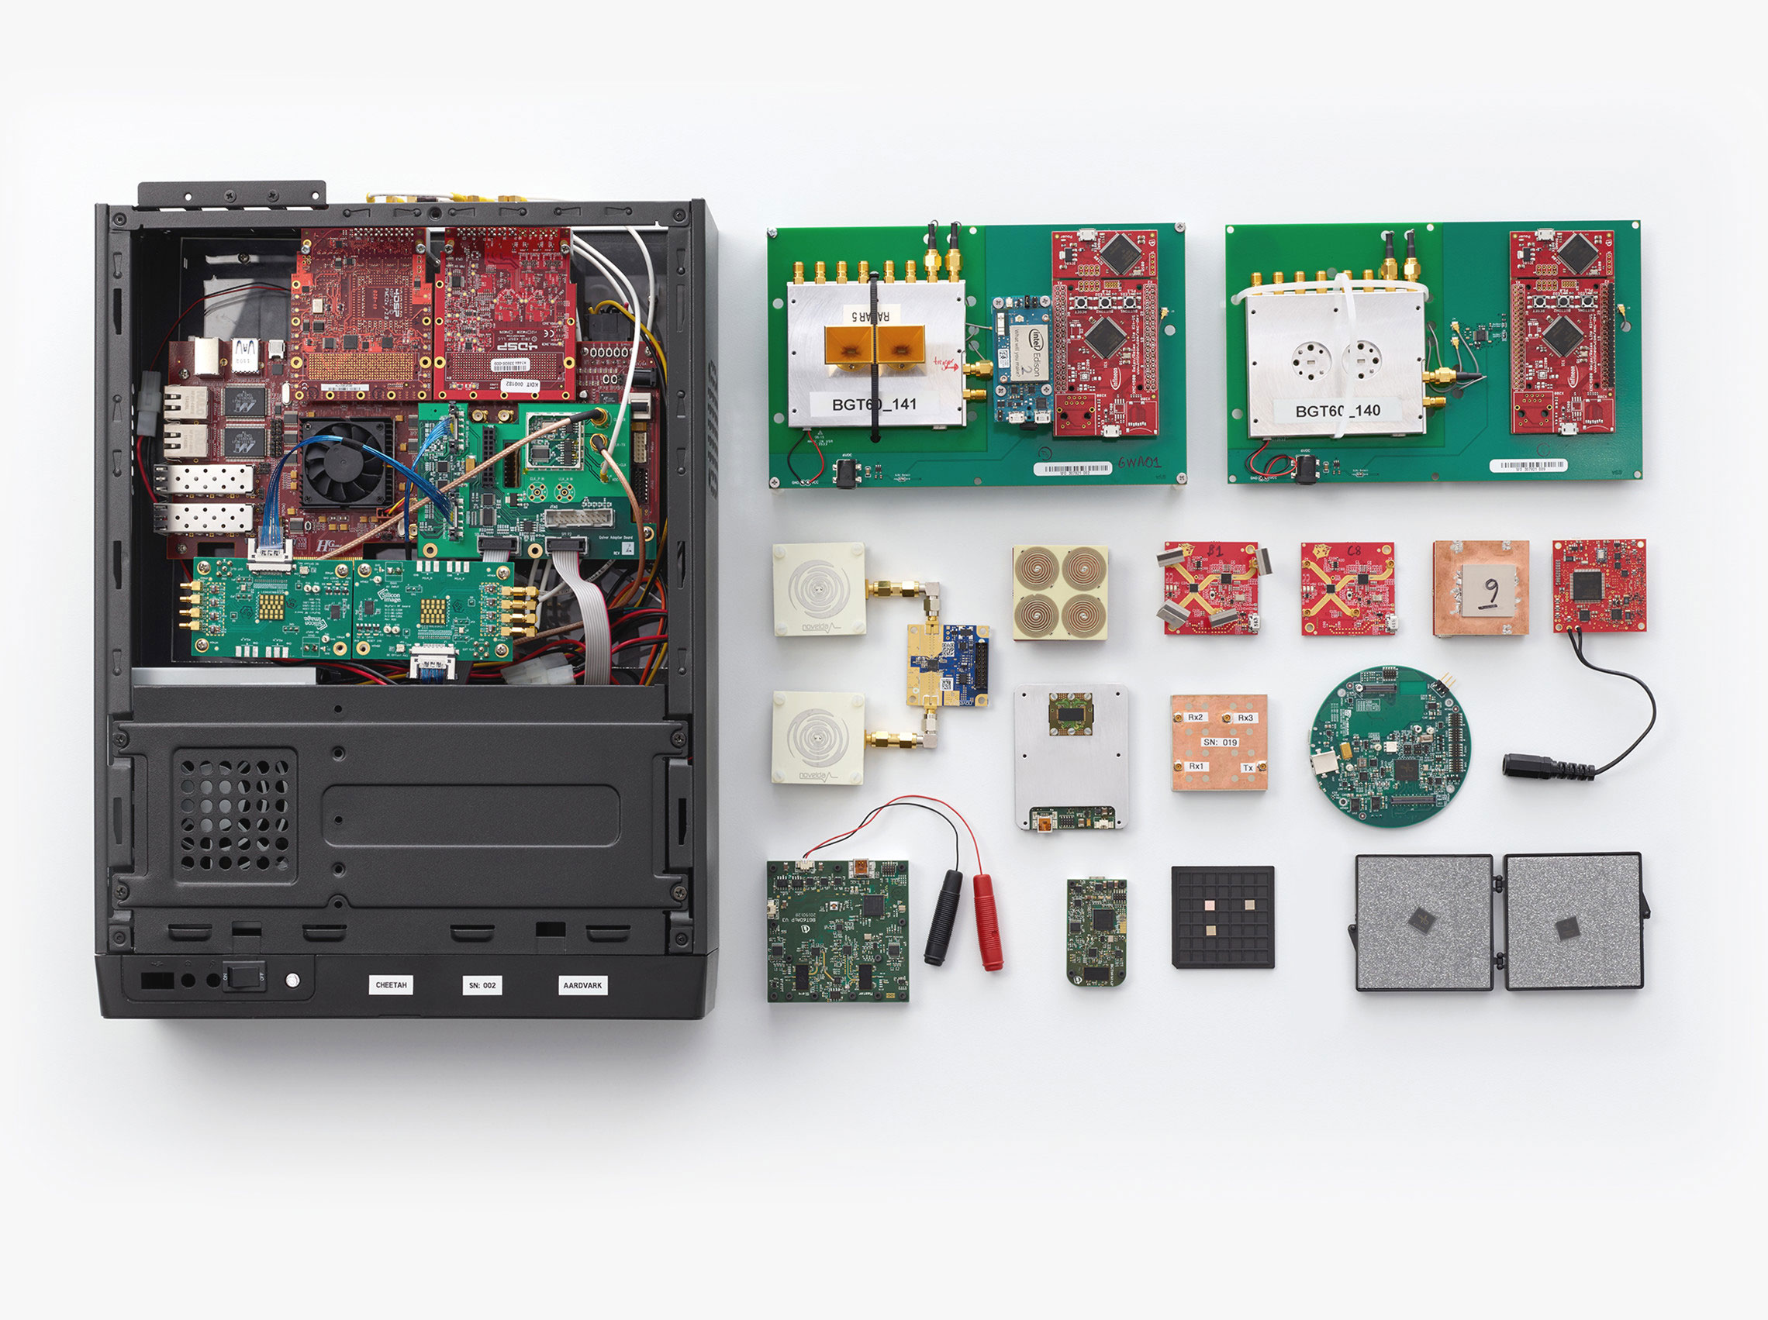
Hardware
Notes:
Two versions
FMCW, DSSS

Slide 7
Hardware
Specs
# of Tx | 2
# of Rx | 4
Tx power | 2 – 5 dBm
Range | 10 m
Carrier | 60 GHz
Signal | FMCW / DSSS
Bandwidth | 7 GHz
Beam width | 150 deg
Power consump. | 300 mW

Slide 8
Signal Model
Scattering center models
Send FMCW chirp or PN sequence periodically
Treat user’s hand as multiple reflectors
Various distance
Various reflection
Notes:
General purpose microprocessor
How to analyze samples
Modeling received samples
Single point model
A group of reflectors

Slide 9
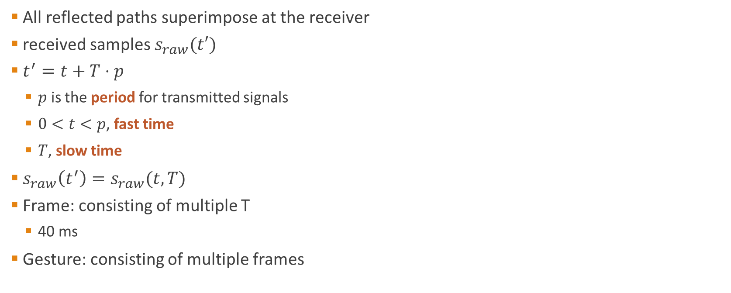
Received Samples
All reflected paths superimpose at the receiver
received samples $s_{raw}(t′)$
$t^{′}=t+T⋅p$
$p$ is the period for transmitted signals
$0<t<p$, fast time
$T$, slow time
$s_{raw}\left(t^{′}\right)=s_{raw}(t, T)$
Frame: consisting of multiple T
40 ms
Gesture: consisting of multiple frames

Slide 10
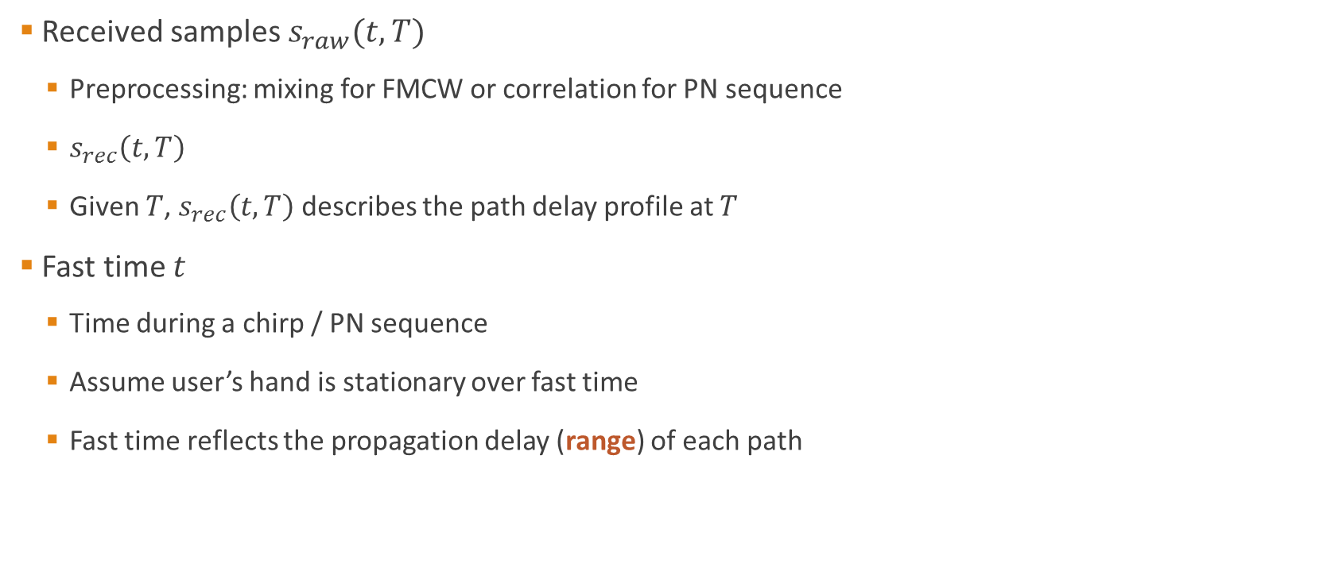
Fast Time
Received samples $s_{raw}(t, T)$
Preprocessing: mixing for FMCW or correlation for PN sequence
$s_{rec}\left(t,T\right)$
Given $T$, $s_{rec}\left(t,T\right)$ describes the path delay profile at $T$
Fast time $t$
Time during a chirp / PN sequence
Assume user’s hand is stationary over fast time
Fast time reflects the propagation delay (range) of each path

Slide 11

Slow Time
Slow time $T$
Time over different periods
Capture the motion (Doppler frequency) of each path over time
Apply FFT on $s_{rec}(t,T)$ treating $t$ as a constant to get Doppler frequency for each path
Using samples in each frame
$S(t,f)$

Slide 12
Range-Doppler Image
Two paths (due to different parts of the hand) are resolvable
Separation in range
Difference in velocity
Use Range-Doppler Image (RDI) to capture the finger-level dynamics

Slide 13
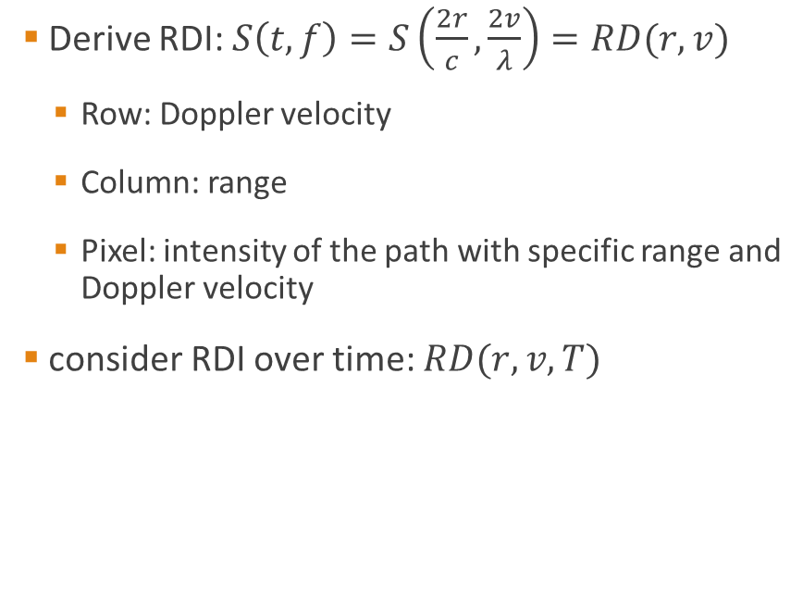
Range-Doppler Image
Derive RDI: $S\left(t,f\right)=S\left(\frac{2r}{c},\frac{2v}{λ}\right)=RD(r,v)$
Row: Doppler velocity
Column: range
Pixel: intensity of the path with specific range and Doppler velocity
consider RDI over time: $RD(r,v,T)$

Slide 14
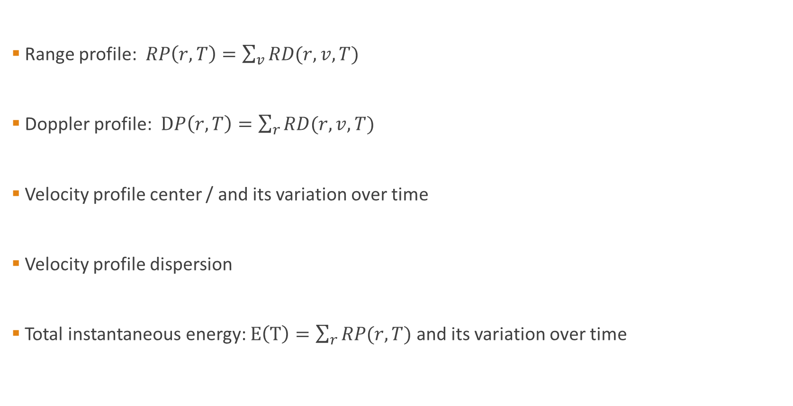
Features
Range profile: $RP\left(r,T\right)=\sum_{v}{RD(r,v,T)}$
Doppler profile: $DP\left(r,T\right)=\sum_{r}{RD(r,v,T)}$
Velocity profile center / and its variation over time
Velocity profile dispersion
Total instantaneous energy: $E\left(T\right)=\sum_{r}{RP(r,T)}$ and its variation over time

Slide 15
Features
Range-Doppler Image matrix
Downsample to reduce the dimensionality
Average over multiple channel
Consider the variation over channels
Consider the variation over time
Raw IQ samples
Derivative over time
Sum of derivative
Maximum channel angle

Slide 16
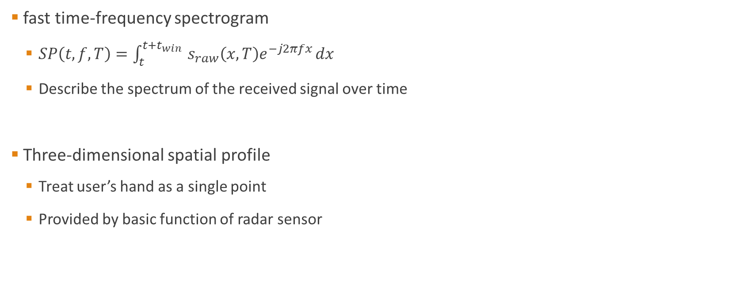
Features
fast time-frequency spectrogram
$SP\left(t,f,T\right)=\int_{t}^{t+t_{win} }{s_{raw}\left(x,T\right)e^{−j2πfx}}dx$
Describe the spectrum of the received signal over time
Three-dimensional spatial profile
Treat user’s hand as a single point
Provided by basic function of radar sensor

Slide 17
Gesture Sets
Action gestures vs sign gestures
Gestures with a motion component
Hard to describe
Associate a gesture to a tool which requires the gesture to operate
Pitch vs button
Rub vs dial

Slide 18
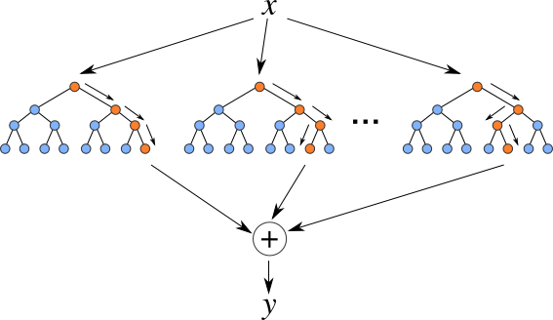
Gesture Classification
Feature vector: 785 elements
Random Forest classifier:
Effective for multi-class classification
Low computational testing cost
Small model size

Slide 19

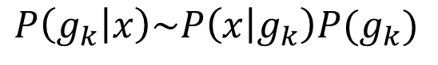
Gesture Classification
Using temporal filtering
Leverage temporal correlation
Bayesian filter
$$P\left(g_{k} | x\right)\sim P\left(x | g_{k}\right)P(g_{k})$$
$$P\left(g_{k}^{T}\right)=z_{k}^{T}\sum_{n}{ω_{n}}P(x^{T−n}|g_{k}^{T−n})$$

Slide 20
Results
Accuracy
Per-frame:73.6% (raw), 78.2% (temporal filtered)
Per-gesture: 86.9% (raw), 92.1% (temporal filtered)
Computation speed
Snapdragon 400 (Quad Cortex A7 at 1.6 GHz): 2880 gesture recognition per second
Raspberry Pi 2 (Quad Cortex A7 at 900 MHz): 1480 gesture recognition per second

Slide 21
Deep Learning based Gesture Recognition
Convolutional Neural Network (CNN)
No manual feature extraction procedure
Use raw RDI as the input
Use CNN to learn features automatically
Recurrent Neural Network (RNN)
Use previous results as the current input
Capture the temporal correlation when performing a gesture
Gradient vanishing and exploding problem
Use Long short-term memory (LSTM)

Slide 22
Network Architecture

Slide 23
Gesture Sets

Slide 24
Training
11 gestures, 10 users, 25 times per gesture
2750 gesture sequences
NVIDIA GeForce TITAN X GPU
Training time ?
Testing time: 150 gesture recognition per second
265 MB GPU memory during running time
689 MB disk needed to store the trained model

Slide 25
Compared Approaches
Standalone shallow CNN
Standalone deep CNN
Standalone RNN
CNN + RNN (proposed)

Slide 26
Classification Accuracy

Slide 27
Temporal Evolution of Performance

Slide 28
Pairwise Classification
 | Gesture 1 (pairwise / entire) | Gesture 2 (pairwise / entire)
Pinch index or pinky | 84.5% / 67.7% | 75.9% / 71.1%
Swipe fast or slow | 95.5% / 84.8% | 92.2% / 98.4%
Push and pull | 97.5% / 98.6% | 59.0% / 89.9%

